Slide 1
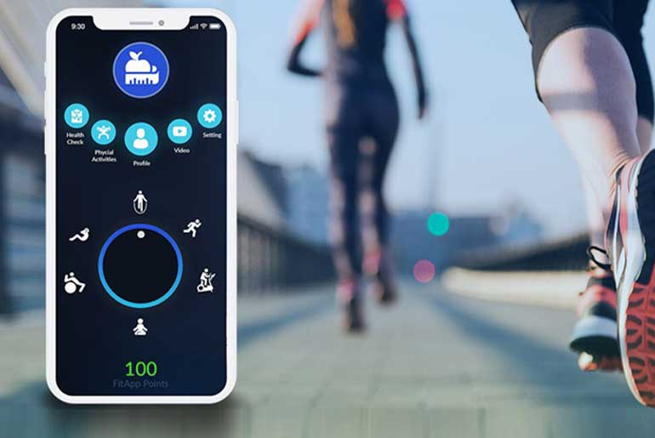

FITNESS APP
Made by VIBHOR JAIN
MCA-III

Slide 2
INTRODUCTION
Since the emergence and popularization of smartphones, many mobile applications that track and record data about their users have been created. The classic example of this is the pedometer which utilizes the mobile device’s built-in accelerometer to track the number of steps the user takes each day. Applications in this category, that track and record health or activity data about their users, are typically called Wellness or Fitness Apps. These Wellness Apps are designed to assist the user in pursuing a healthy lifestyle by encouraging them to perform positive activities, and improve lifestyle choices. Factors that are typically targeted by such applications include exercise, sleep, and diet. Understanding the nature of this relationship is crucial when designing a Wellness App

Slide 3
Objectives & Scope
Studies have shown the positive effects that increased exercise can have on a person’s overall mood, and it has been widely recommended that people suffering from a history of mental disorders such as depression and anxiety incorporate more exercise into their daily routines

Slide 4
METHODOLOGY
TOOLS AND PLATFORM
Hardware Requirement:
Processor: intel CORE i5 RAM: 2GB or more
HD: 500 GB
Software Requirement: Operating System : Windows 10

Slide 5
Modules (FEATURES)
the fitness app features :
Fitness goal calorie, fitness tracker, fitness calorie calculator

Slide 6
Fitness goal calorie:
A calorie is a unit that measures energy. Calories are usually used to measure the energy content of foods and beverages. To lose weight, you need to eat fewer calories than your body burns each day.
fitness tracker-A fitness tracker is a device that uses sensors to track your orientation, movement, and rotation. The device collects data and converts it into steps, calories, sleep quality and general activity you perform through the day. ... A fitness tracker can easily figure whether you are running or spinning.

Slide 7
Fitness calories calculator: Use our calorie-intake calculator to determine your daily caloric needs based on your height, weight, age and activity level. In addition to determining the calories needed to maintain weight, use this as a calorie burner calculator and figure out how many calories you need to burn in order to drop pounds. Then use the nutritional needs calculator and figure out how to break those calories into carbs, proteins and fat.

